Slide 1
Formula Master
Overview & Details
29th November, 2016

Slide 2
Overview
Formula Master gives the user flexibility to add/delete/edit formulae for Financial Parameters and/or Ratios required for the Credit Analysis Tool.
The user can select the pre-defined sections to add/update/delete formulae defined for parameters or ratios –
Profit & Loss
Balance Sheet
Ratios
Cash Flow Statement
If the User selects Profit & Loss or Balance Sheet from the drop down, he/she can view the layout as defined in Balance Sheet Inputs Master. User can add a new formula and place the parameter in the layout as desired and also change its position using the Up/Down arrows.
If the User selects Ratios from the drop down, he/she can view the different sections –
Profitability Ratio
Leverage Ratio
Operating Ratio
Key Ratios (Calculated only for one year as per availability of numbers for the ratio in the order of preference – Estimated > Latest available Provisional > Last Audited)
Liquidity Ratio
Other (Supporting and general Ratios can be moved to this section)
User can create a formula to be placed in Ratios section and move it to the appropriate section using the up/down arrows.
Cash Flow Statement does not have a layout defined, User can create a ratio or parameter and arrange the same required to be displayed in the reports.
Data Output – Saving the changes made on editing or adding new formula is reflected directly in –
DFR
KFR
Loan Approval Report
Loan Approval Form
Credit Score Card

Slide 3
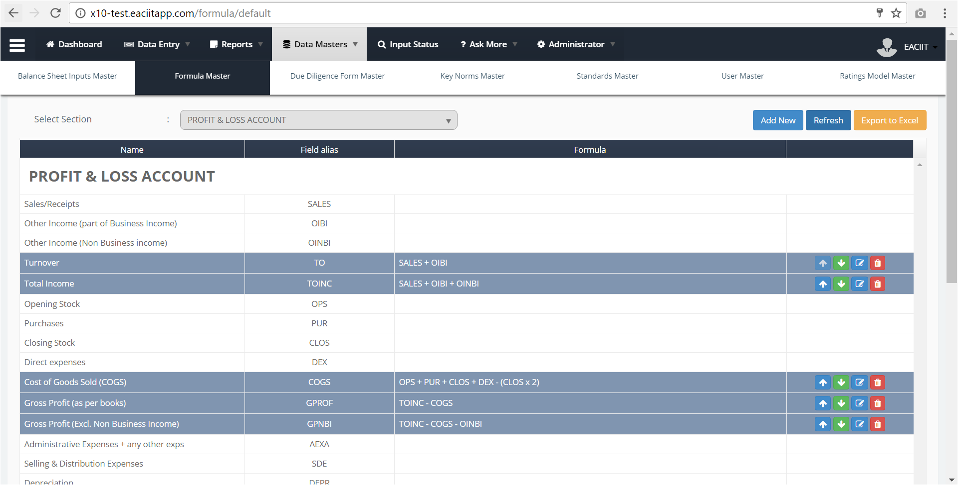
White cells show the structure defined in Balance Sheet Inputs Master. Blue cells show the formulae defined.
User can select the section where the formula needs to be created / updated
User can select the section and hit refresh to update the layout as per selection.
Up / Down buttons to change the positioning of the parameters in the layout.
Edit button (blue) to update the parameter.
Delete button (red) deletes the formula form the Master and Reports.

Slide 4
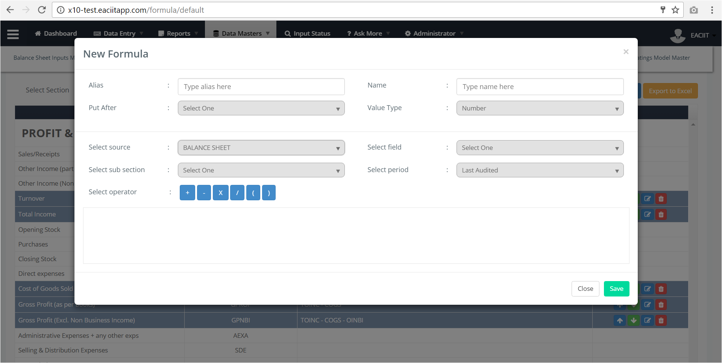
User must enter an alias for the new parameter.
This is a mandatory field.
User must enter name of the parameter for which formula has to be defined here.
This is a mandatory field.
User must select the type of the formula from the dropdown.
It can be Number or Percentage.
It is a mandatory field
User must select the field to be used in the formula to be created.
It is a mandatory field.
User must select the time period of the field selected. This is applicable only when User has Source selected as Balance Sheet, Profit & Loss, Ratio and Cash Flow Statement.
Default value for this drop down is Last Audited. Period comes useful when a formula has to be defined across years.
It is not a mandatory field
User selects the source to select the parameter to include it in the formula equation from the dropdown.
Dropdown comprises of Profit & Loss, Balance Sheet, Ratio, Cash Flow Statement, Account Details, Banking Analysis, CIBIL and RTR.
This is a mandatory field.
The fields and operators selected by the User can be seen in this editable box.
User can delete fields or operators added in the formula using the keyboard or mouse if required.
User can enter numbers if required in the formula to be defined.
User must select relevant operators as required to define the formula. The order of operators must be mathematically correct.
User can select a sub-section if applicable and required. This drop down appears based on what has been selected as a Source.

Slide 5
<End of Formula Master Specs>

